Slide 1



Slide 2
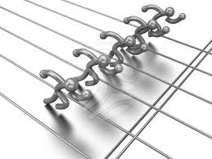
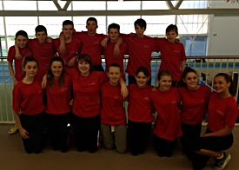
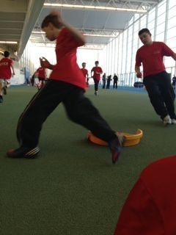
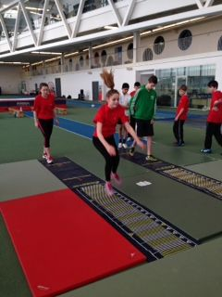
DYCE PE PRESS
Mar
2014
Pupils test their Stamina
as they compete in the
Aberdeen Schools
Giant Heptathlon
15 of our S2 pupils competed in this year’s Giant Heptathlon @ Aberdeen’s Sports Village on
Friday 7th March.
Pupils took part in a morning training session followed by the Aberdeen Inter-school’s competition
against 12 schools from the city.
All pupils worked exceptionally hard to gain points
for their school, despite exhaustion creeping in.
All the pupils thoroughly enjoyed the opportunity to compete for their school and the sore muscles afterwards showed how hard they worked.
A great day was had by all!

Slide 3
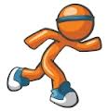
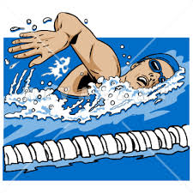

SPORTS RELIEF 2014
Well done so far to all pupils who have started their sponsored run, swim or 3-legged challenge for Sports Relief 2014.
We have witnessed some very motivated individuals and have been thoroughly impressed so far with the efforts of all pupils.
Please continue to gain sponsorship for your challenge and remember to set your goal. We will display all results/mileage on our main
notice board in the PE corridor.
We have individual, class, year group and whole school mileage recorded. A total of the money raised will also be displayed.
Keep striving for your set mileage goal!!
We ran/swam – 1604 Miles
PE event money raised – £1121.21
Wrist Bands + staff event – £ 238.07
Total Money Raised – £1359.28

Slide 4
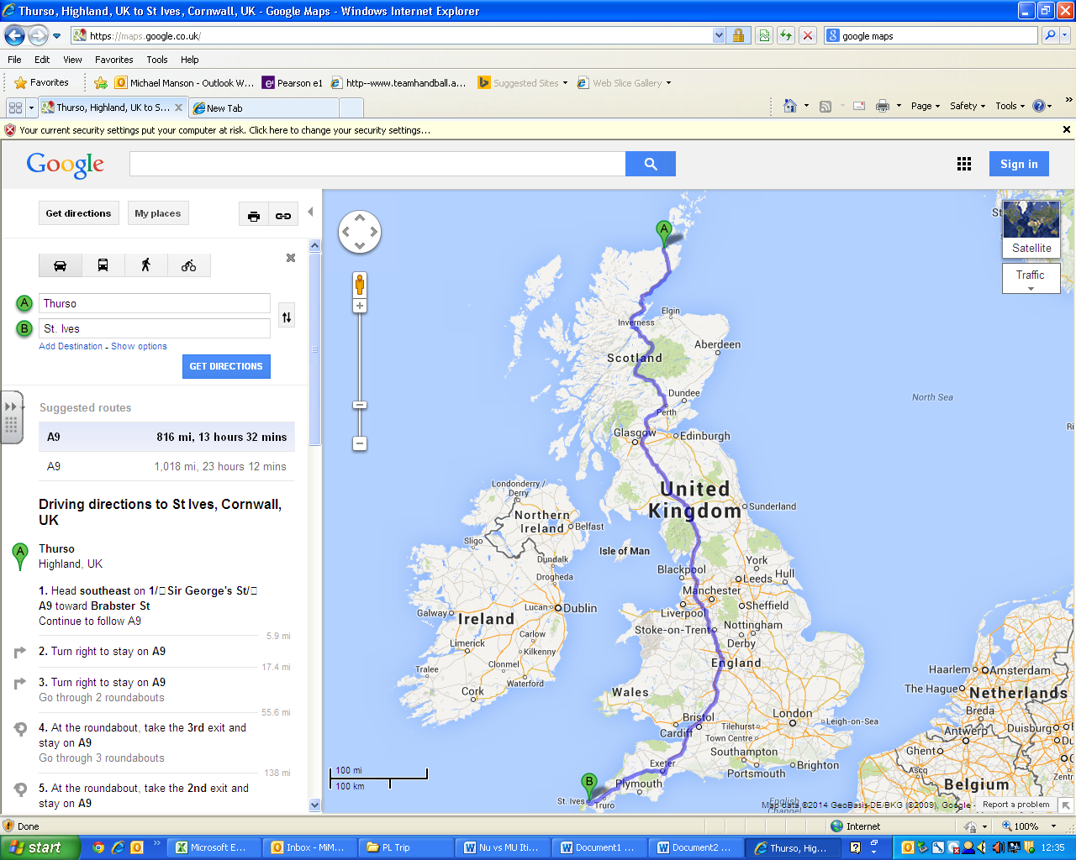
SPORTS RELIEF 2014
1604 Miles
This is equivalent to running
on the road
from
Thurso to St Ives
&
back again!!

Slide 5

Sports Fair
Another first for Dyce Academy was its Sports Fair, organised by the Sports council.
Each council member was in charge of promoting an activity. Pupils put in huge amounts of effort to produce posters, music and demonstrations that would capture the attention of the pupils in Dyce Academy. They did a fantastic job! Well done guys!

Slide 6
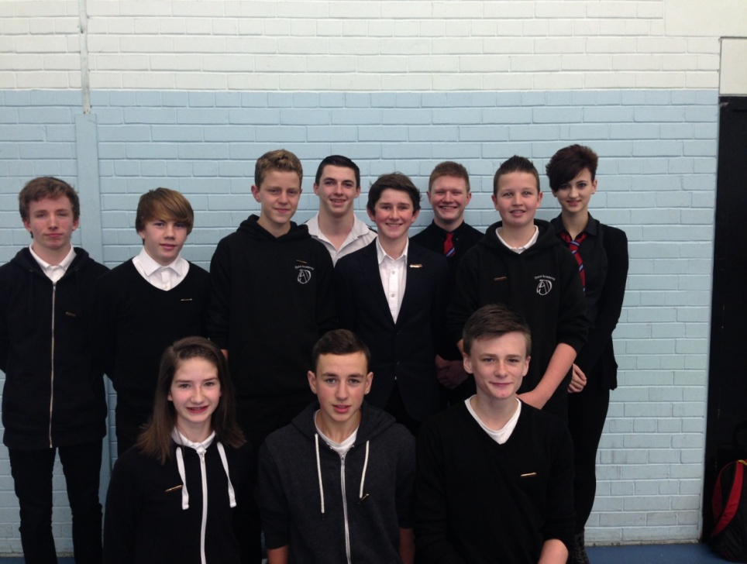
OUR
SPORTS COUNCIL
This year in Dyce Academy we have our first ever Sports Council.
This is led by our three Young Ambassadors:
Toby Keech (Platinum Young Ambassador),
Cait Cormack and Declan Coutts.
Our Sports Council panel consists of S3 pupils who will be taking part in the
LEAD 2014 programme in March.
These S3 pupils were chosen as they showed excellent leadership and organisational qualities as well as a love for sport and a desire to improve the opportunities for pupils to take part in
extra-curricular sport/activities at Dyce Academy.
Back (L-R): Cameron Brown, Ethan Wilson, Aaron Odentz,
Declan Coutts, Andrew Frank, Toby Keech,
Jake Shade, Cait Cormack. Front
(L-R): Kim Moir, Connor Ross, Lewis Cowie
The Sports Council meet on a Friday lunchtime every two weeks to update each other on what is happening with their clubs and discuss new and exciting ways of delivering the variety of sports on offer to the pupils of Dyce Academy.
We have a full timetable of activities for pupils to take part in which includes:
Badminton, Trampolining, Insanity, Girls Football, Ultimate Frisbee, Table Tennis,
Martial Arts, Rugby, Netball, Volleyball, Basketball and Dance.
Please see our activity timetable.

Slide 7

Congratulations Toby!
Toby Keech our Platinum Young Ambassador was chosen to sit on a panel within Aberdeen City Council, to help choose runners for the Queens Baton Relay when it arrives in Aberdeen. This is a massive achievement for an S5 student, and I have no doubt that you represented Dyce Academy extremely well!
Toby has been selected to become part of a National Steering Group for Young Ambassadors. This group aims to raise the profile of the
Young Ambassador programme in their area and help to ensure Sport Scotland are meeting the needs of Young Ambassadors participants in the programme across the country.
As part of the steering group Toby will have an opportunity to share learning with Young Ambassadors from across the UK, to develop the Young Ambassadors programme to ensure it meets the needs of young people, share practice to
understand the challenges and celebrate the successes in the programme. As well as attending both the Young Ambassadors Regional Implementation Group and support their Regional Young Ambassadors Conference in 2014.
This a huge honour as Toby is the first Young Ambassador from Aberdeen City to be chosen to become part of the group!
Well done Toby!! We here in the PE Department have no doubt that you will do a fantastic job! We are very proud of you!

Slide 8

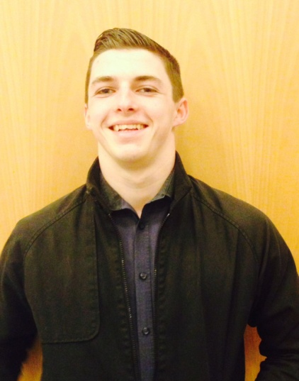
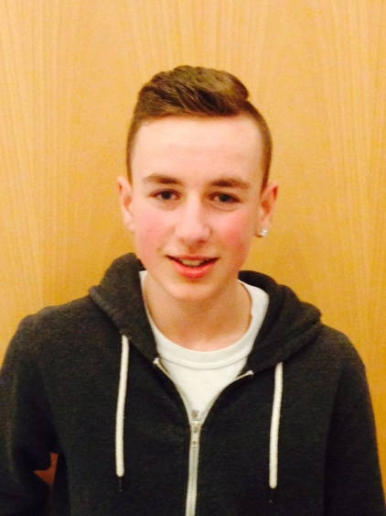
SPORTS COUNCIL REPS
Two other members of our Sports Council
have been very busy!
Both Declan Coutts, S5 and Conor Ross S3, have applied to become part of a Young Peoples Sports Panel for Scotland. This panel is open to people aged 14-24 and aims to give a voice to young people, and has been formed through a partnership between SportScotland and Young Scot.
Already the Sports Panel have been involved in a wide range of activities, from influencing policy through the Youth Sport Strategy, Commonwealth Youth Sport Charter and Children and Young People's Bill, to creating online content for the Young Scot website encourage more young people to take an interest in sport.
We wish both Declan and Conor the very best
of luck in their application!

Slide 9


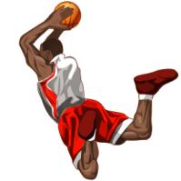
S3
The 20 pupils participating in the Level 1 Sports Leaders award have been making excellent progress over the last few months. The group have been developing their leadership and communication skills when in Core PE lessons.
Their leadership qualities were put to the test at the beginning of February when the Sports Leaders organised and officiated an S3 Dodgeball tournament. The event went very well and everybody enjoyed themselves.
The Sports Leaders will be embarking on their most challenging task in the coming weeks when they will go to Dyce Primary school. Whilst at the Primary the Sports Leaders will be delivering a variety of lessons to the P6's under the supervision of Miss McLuckie (Dyce Primary) and Mr Manson.
Good Luck to all involved!
PHYSICAL EDUCATION
SPORTS LEADERS
S5&6
The senior Sports Leaders are working hard at the moment to complete their Level 2 Award.
They have been busy developing their skills within S3 Core classes and are looking forward to continue this within the primary schools in the oncoming weeks.
Keep an eye out for Melissa McIntosh,
Declan Coutts, Josh Cruickshank, Scott Fowler, Simeon Georgier and Chris Taylor, who will be hosting more events and competitions within the PE Department in the future.

Slide 10

Our U16 Football Team
We played in some fantastic matches over
the season against
Albyn, Aberdeen Grammar School, Hazlehead Academy, Westhill Academy & Kincorth Academy.
All boys worked extremely hard throughout every match this year with great enthusiasm & determination!

Slide 11
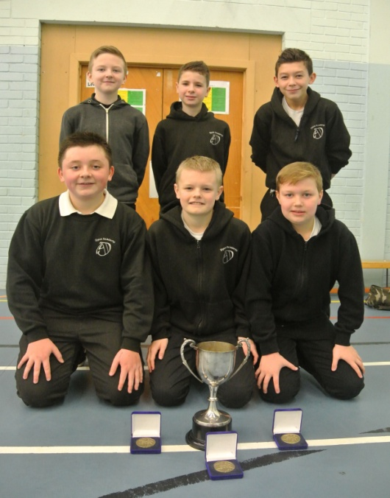
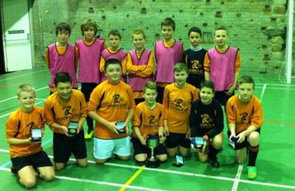
Our S1
Football Teams
On Friday the 21st February Dyce Academy entered into the NORCO Trophy at Hazlehead Academy. Dyce were separated into two teams, A and B.
The A team were placed into a group with Torry and Mintlaw A which proved to be a fiercely contested group. Dyce A were narrowly beaten 3-1 by Torry and just lost out 3-2 in an epic encounter against Mintlaw A. In group 2 Dyce B were entered with Hazlehead and Mintlaw B were they emerged victorious in a 4-1 against Hazlehead and drew 1-1 against Mintlaw B.
Dyce A then played in a 5th v 6th placed playoff against Hazlehead in which Dyce won 4-1. Dyce B finished top of their group and played against Torry (the winners of the group 1) in the final. It was an epic encounter where Dyce fell 1-0 behind in the early stages of the game.
However, Captain Ross MacGregor was not going to let the opportunity of silverware pass them by as he picked the ball up in his own half and curled a shot into the top corner of the Torry Goalkeepers net. Some 'backs to the wall' defending then incurred with Goalkeeper Mack Mclennan and defender Jordan Beadie giving everything for the cause.
With regular time not being able to separate the two teams, it came down to penalties to decide who would walk away with the coveted trophy. Penalties for Dyce were all converted with precise accuracy, so it came down to Goalkeeper Mack McLennan to win the game for Dyce which he did with a great reaction save!
A massive well done to all the boys who took part and a big thank you to our S4 pupil, Ben Soutar, for coaching the Dyce A team.
All pupils conducted themselves well and were a credit to themselves and the school.
Well done all!

Slide 12

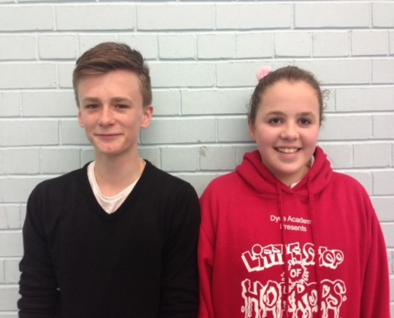
Queens Baton Relay
The Queen’s Baton Relay is a much loved tradition of the Commonwealth Games. It was introduced at the British Empire and Commonwealth Games in Cardiff in 1958. From there, it has developed as a symbolic celebration of both unity and diversity, binding the 70 nations and territories of the Commonwealth with the message of peace and harmony through sports.
We were given a truly once-in-a-lifetime opportunity to select a pupil to carry the Queen’s Baton.
So we ran a competition in school to research the ways in which people in other Commonwealth Countries build physical activity into their day; either within the school day or at home.
From a number of entries, which are displayed in corridor near the department, we selected our
winner and runner-up:
Winner - Lewis Cowie, S3
Lewis’s outstanding presentation on Physical Activity in the Commonwealth Countries exemplifies
his character and personality. A talented Gymnast, he puts in tremendous effort, commitment and dedication to improve. Despite an intensive training schedule, Lewis attains excellent grades in school. He is always respectful to opponents/team-mates alike and his generous spirit is apparent when volunteering and coaching younger pupils, sharing his expertise. His voluntary contributions to the wider school community and curriculum life of the school is done in a very modest fashion and he is a natural leader and exemplary role model, being a friend to all who know him.
Runner-up - Jordan Coutts, S2
Jordan was runner up in the school selection competition for the Baton Relay nomination, having produced an excellent and imaginative presentation. This highlighted her hardworking and dedicated attitude and desire to always do her best. Both in and out of school she demonstrates a very strong sense of responsibility and social conscience, involving herself with the School Charities committee and outside school, the Scouts. She shows everyone respect and is always helping her classmates and peers. She is also very active, attending dancing, school sports clubs and running to keep fit and she has an ambition to be a PE teacher.

Slide 13



WIMBLEDON TRIP 2014
Mrs McCaw has organised a trip for forty one S1 – S6 pupils.
It is a three-day break to experience to
The Wimbledon Tennis Championships 2014
between 1st July – 4th July 2014.
The trip includes 4 days exclusive coach travel, with collection to and from Dyce Academy, two nights hotel accommodation, with
continental breakfast, official tickets for Court 2 (2nd July) and
Court 1 (3rd July) and the services of an experienced
Tour Manager throughout the short break.
All pupils are thoroughly excited and can’t wait for July!
OUR TWITTER ACCOUNT
@DycePE
Last payment of £58.50 due
1st April 2014

Slide 14
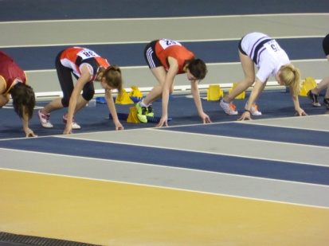
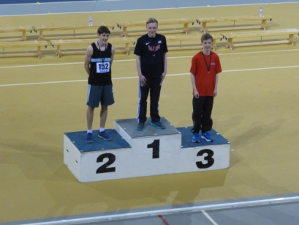
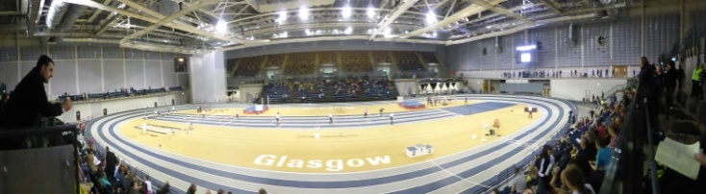
ATHLETICS CHAMPIONSHIPS
Scottish Schools Indoor
Track & Field Championships
Six keen bean athletes hit the road to Glasgow on Thursday 6th February in a bid to get on the podium at the Championships. The event took place at the Emirates Arena and included performances from Yasmin Mtichell, Aaron Odentz, Grace Carter,
Julia McAllan, Cameron Brown and Connor Wood.
Each athlete impressed in the Heats however Cameron Brown managed to take the edge and progressed to the finals. Cameron finished his 200m run in a blistering pace and secured a bronze medal. Well done to all the pupils that represented the school and many thanks to the parents for the help in getting the pupils to and from the event. Fantastic effort from all!

Slide 15

NEWCASTLE v MAN UTD TRIP
Mr Manson’s is organising an
S1-6 Football Trip to Newcastle’s grounds St James Park on the
5TH APRIL 2014

Slide 16


Ladies!!!
Miss Macphee has worked extremely hard to recruit staff and
pupils from Dyce Academy for the
Race for Life 2014!
Sunday 22nd June at 11.00 am, Aberdeen Beach.
The total number of sign-ups has now reached 86!
Excellent work!!
Race packs and t-shirts to follow.

Slide 17
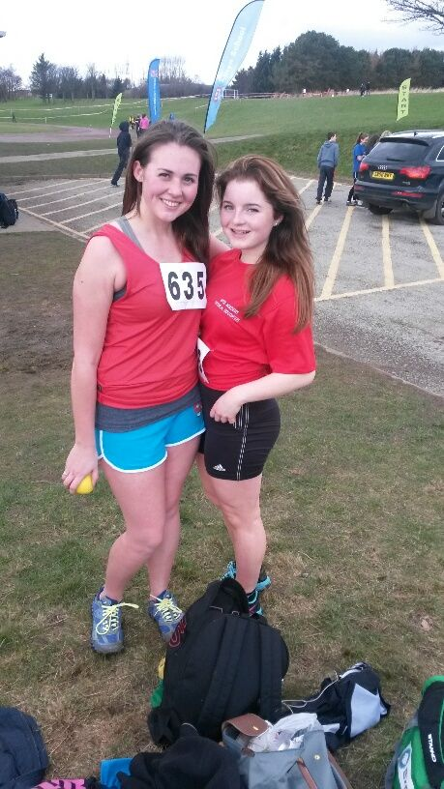
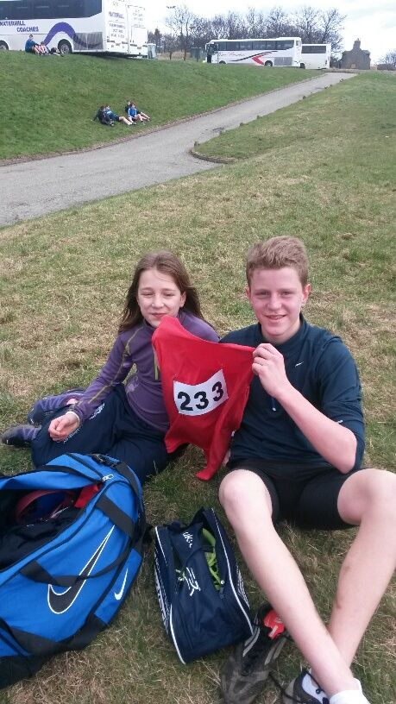
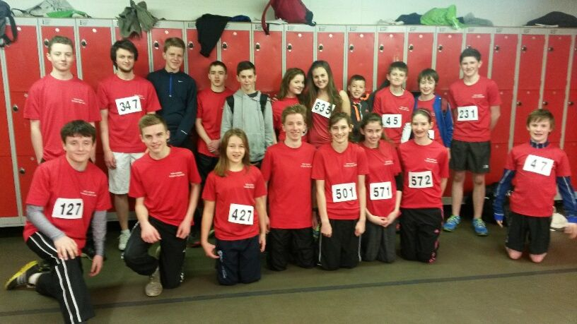
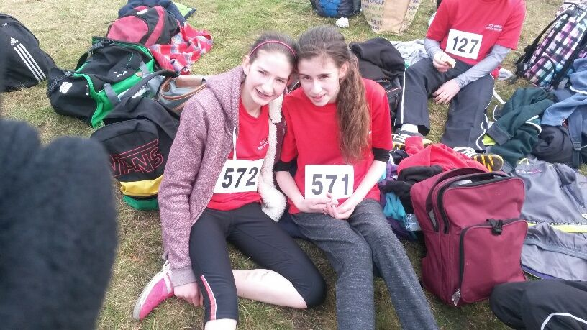

CROSS COUNTRY CHAMPIONSHIPS
Ms Cullen & Mrs Florence took many of our pupils from
S1 – S6 to compete in the
RGC & Albyn Invitational Cross Country Championships
On Friday 14th March 2014 @ the Balgownie Playing Fields.
Well done to all those pupils who trained extremely hard to prepare for this inter-school event and ran their hearts out on the day!

Slide 18

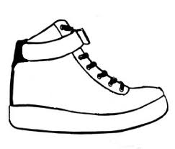
Sport your Trainers for
Commonwealth Day,
Monday 10th March 2014.
Posters were displayed round school to raise awareness of Commonwealth Day 2014. Each poster highlighted interesting facts about Commonwealth Countries & the upcoming Commonwealth Games in Glasgow!
The Queen’s Baton
Relay will cover more
than 190,000km.

Slide 19
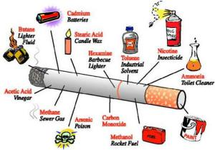
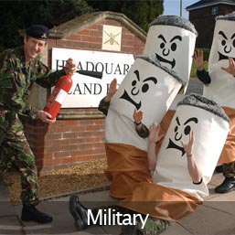


Improve your Health &Wellbeing
Are you
drinking 2 litres
of water
every day?
Are you
eating your
5-a-day?

Slide 20

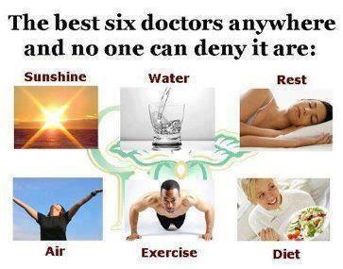
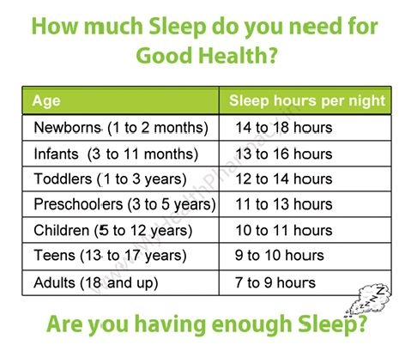

Slide 21
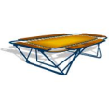











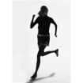

DAY | LUNCHTIME 1.00 – 1.35PM AFTER SCHOOL 2.45 – 3.45PM |  | SPORTS COUNCIL MEMBER | STAFF | AFTER SCHOOL (See specified times)
MON | S1 & S2 TRAMPOLINE S1 - S6 VOLLEYBALL |  | Lewis Cowie Simeon Georgier | Mrs McCaw Miss MacPhee | Extra Curricular Activities @ Dyce Academy COME & GIVE IT A GO!!
TUES | S2 & S3 NETBALL MARTIAL ARTS |  | Katie Monroe Declan Coutts | Mrs McCaw Mr Manson
WED | GIRLS FOOTBALL INSANITY |  | Kim Moir Linsey Duffin | Miss Weir Mrs Lawrenson
THURS | S1 FOOTBALL DANCE S1 BADMINTON |  | Ben Soutar & Owen Shand Cait Cormac Jake Shade Ethan Wilson | Mr Manson Dance Leaders Miss Hughes | S1-4 RUGBY 4.30 – 6.00 pm Call Katrina Hamilton 07920213552 | PRIMARY 7 GYMNASTICS 3.30 – 4.30 pm Miss McLuckie
FRI | TABLE TENNIS CROSS COUNTRY TRAINING BASKETBALL |  | Connor Ross Cameron Brown Ethan Wilson | Mrs Keith/ Mrs Smith Ms Cullen Miss MacPhee | JOIN UP, JOIN IN!!

